Slide 1
Anti-ARP system to detect, prevent and recover from Man-in-the-Middle attacks
(ISM Review – 3)

Slide 2
Submitted by..
Krish Jani – 18BEC1010
Madhav Chaturvedi – 18BEC1036
Nitesh - 17MIS1098
Devadathan - 17MIS1105

Slide 3
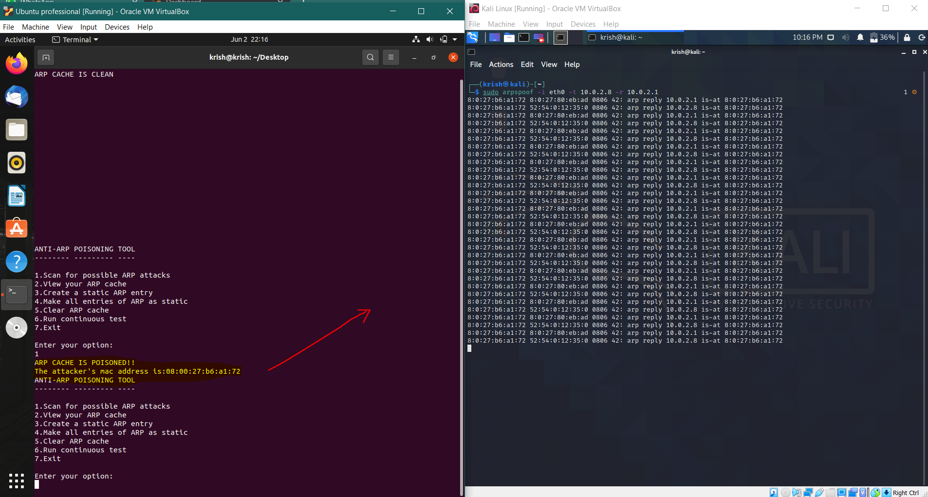
Detection of the attack:

Slide 4
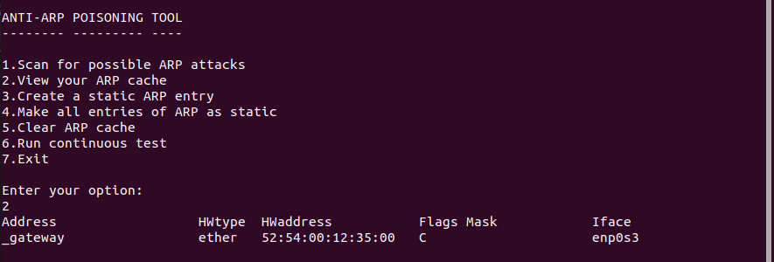
Prevention:
First we’ll observe the ARP cache.
Here the flag masks are denoted with ‘C’, that means it’s dynamic and hence out system is vulnerable to the attack.

Slide 5
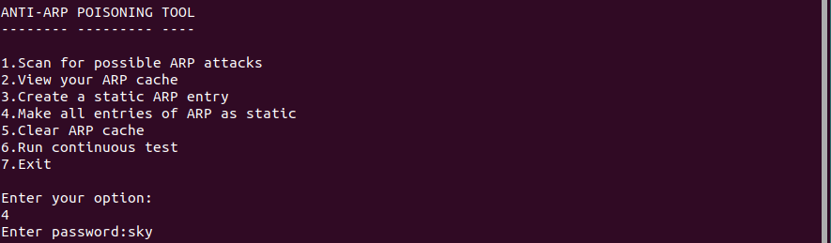
Cont…
Now, in order to prevent the attack from being performed, we have to change the ARP cache from dynamic to static.

Slide 6
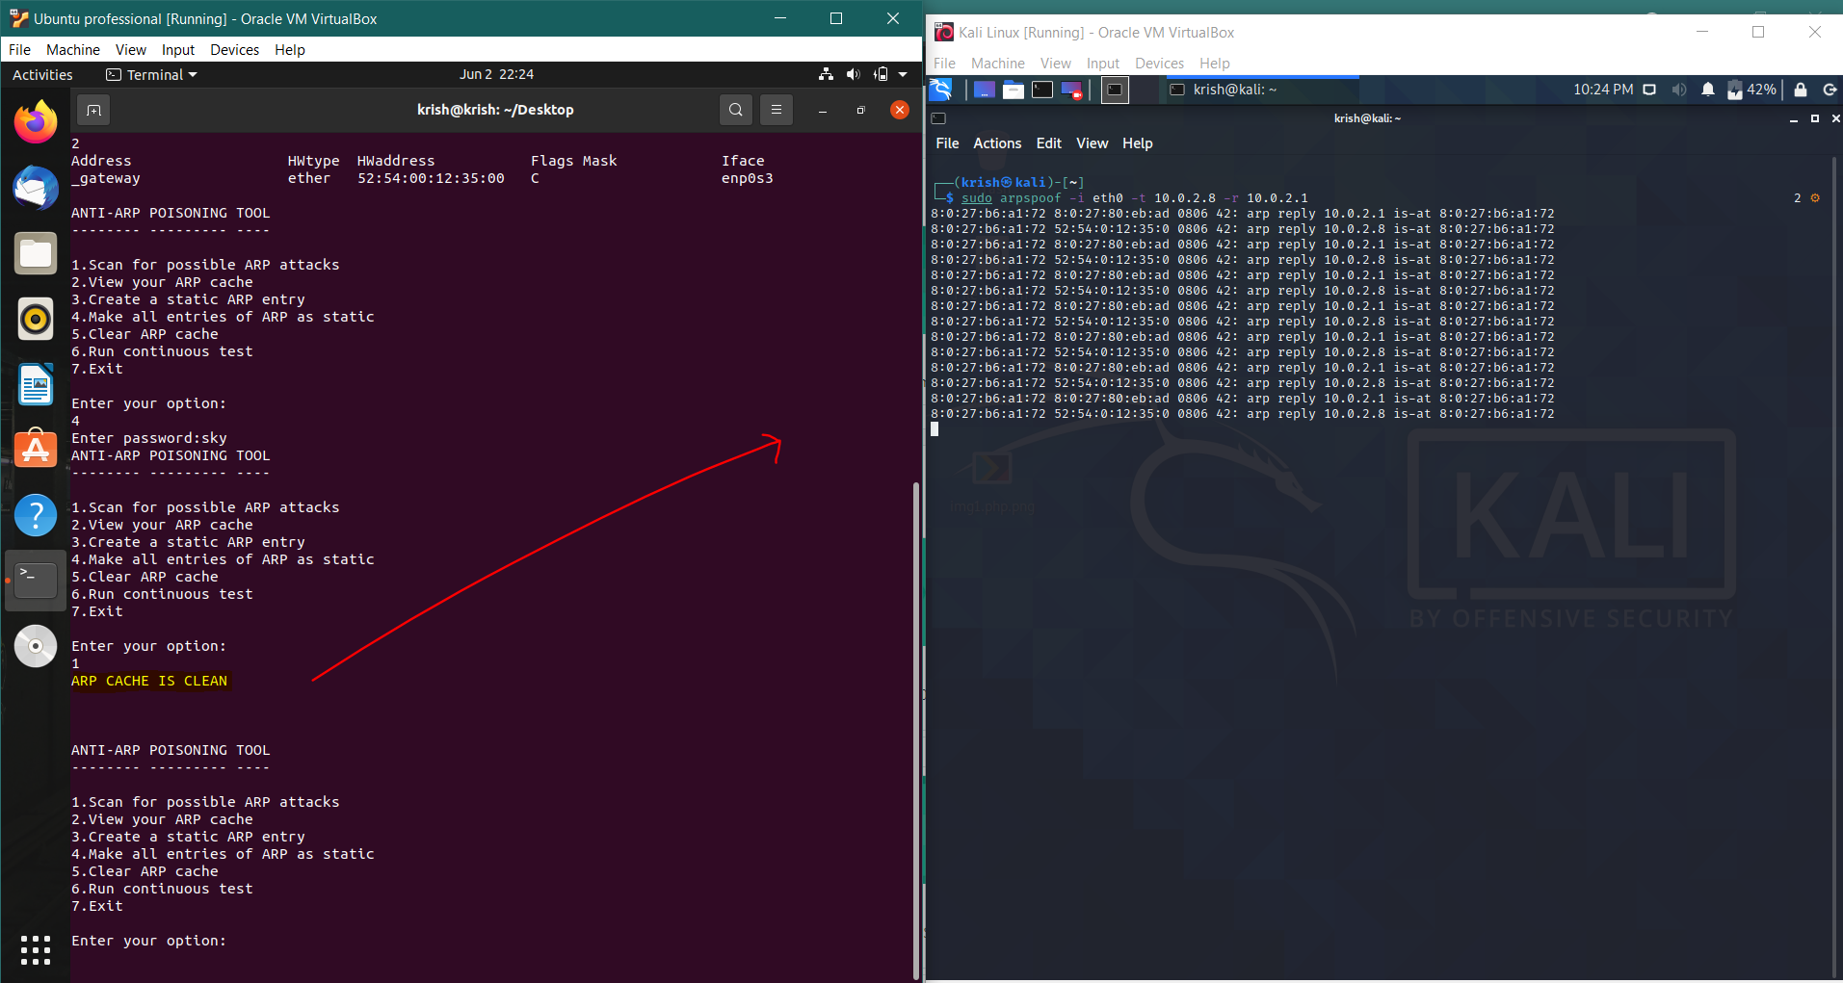
Cont..
Here as we can see, even if we perform the attack, the ARP cache is clean.

Slide 7
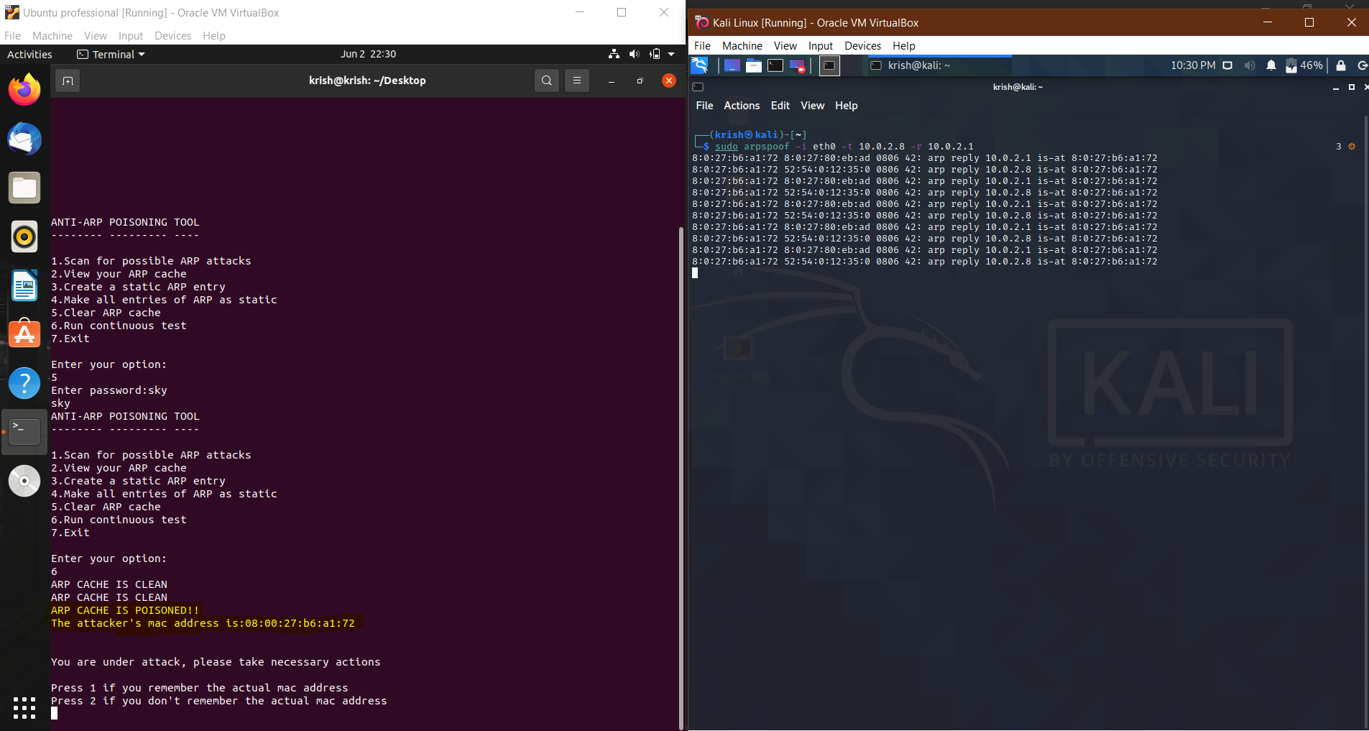
Recovery:
Here we have an option to run the test continuously.

Slide 8
Cont…
Now once the attack is detected, it will ask us if we remember the actual mac address. In this case we don’t.
So the system will find the actual MAC address from the previously stored clean set of values and restructure the ARP cache.
Once this is done, our ARP cache is clean again, as it was before the attack happened.

Slide 9
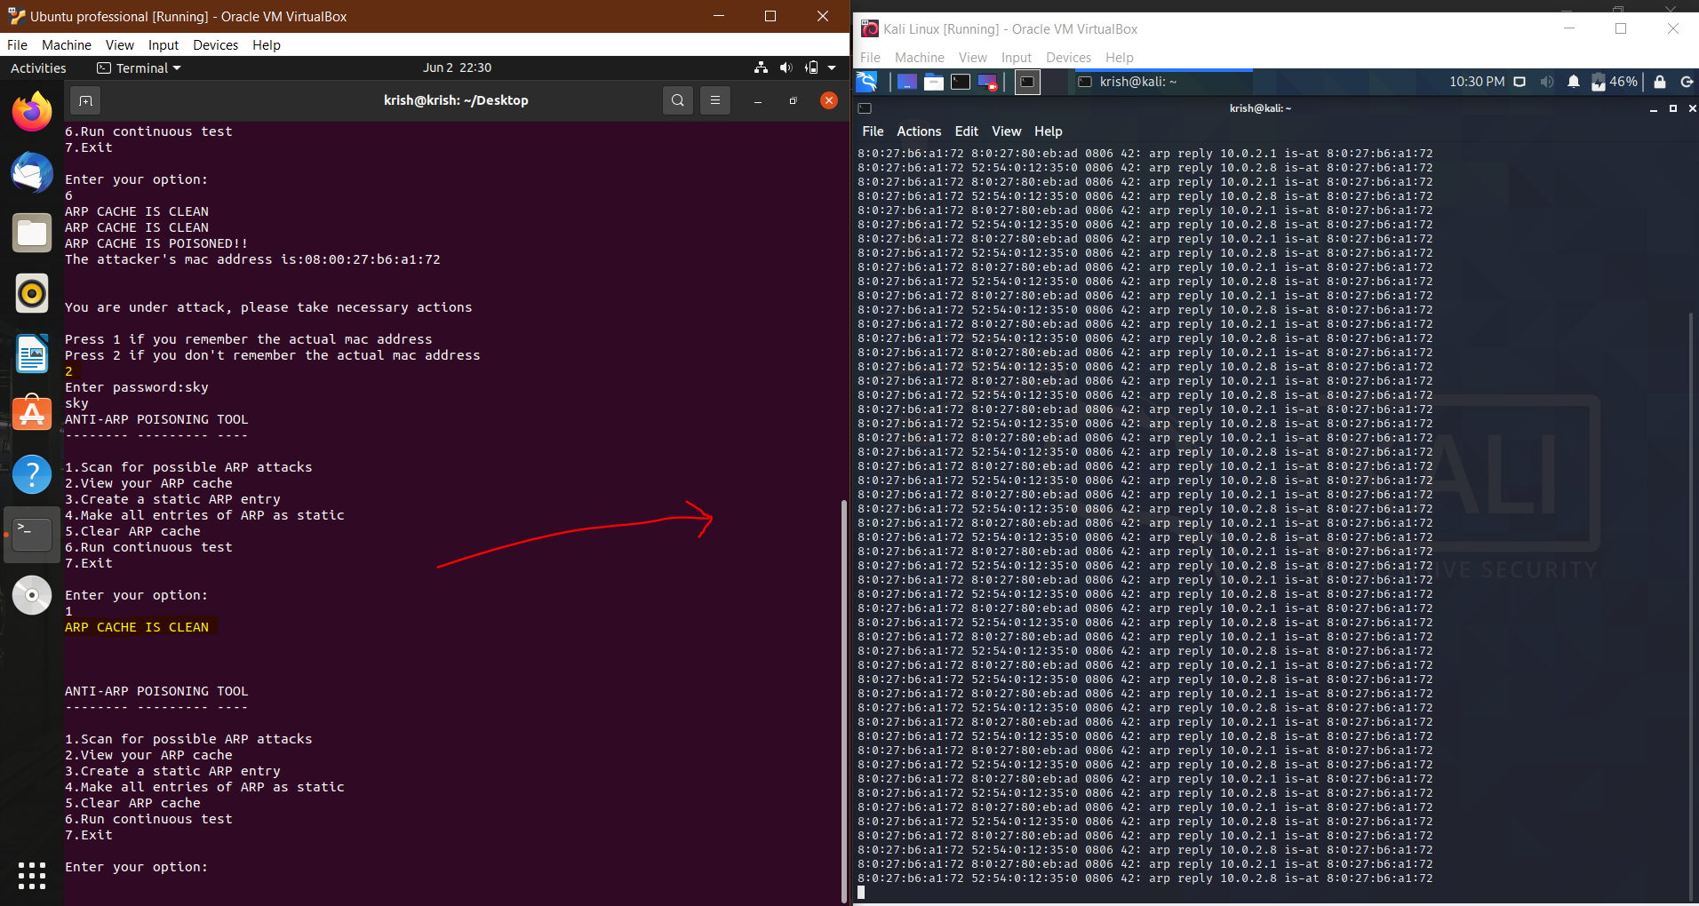
Cont…

Slide 10
References:
[1] Y. Kim, S. Ahn, N. C. Thang, D. Choi and M. Park, "ARP Poisoning Attack Detection Based on ARP Update State in Software-Defined Networks," 2019 International Conference on Information Networking (ICOIN), Kuala Lumpur, Malaysia, 2019, pp. 366-371, doi: 10.1109/ICOIN.2019.8718158.
[2] B. Zdrnja, "Malicious JavaScript Insertion through ARP Poisoning Attacks," in IEEE Security & Privacy, vol. 7, no. 3, pp. 72-74, May-June 2009, doi: 10.1109/MSP.2009.72.
[3] S. Kumar and S. Tapaswi, "A centralized detection and prevention technique against ARP poisoning," Proceedings Title: 2012 International Conference on Cyber Security, Cyber Warfare and Digital Forensic (CyberSec), Kuala Lumpur, 2012, pp. 259-264, doi: 10.1109/CyberSec.2012.6246087.

Slide 11
Appendix:
The python code, screen recordings and the remaining documents can be found here:
https://drive.google.com/drive/folders/1CeUG0VdYBlS0V9K9JsO6C-3XIZPOpmVB?usp=sharing

